Slide 2

Mohit Chhabra
Microsoft Azure MVP
Cloud Operations Manager and Architect, Configit

Slide 3
Secure your SQL Data with the power of Blockchain

Slide 4

What is Blockchain ?

Slide 5
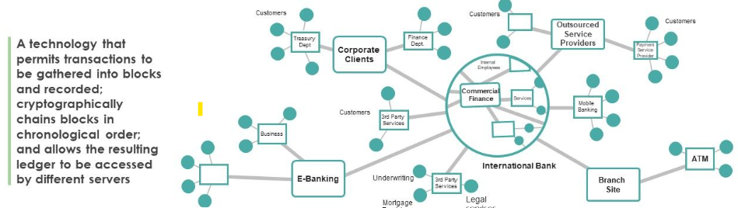
What is blockchain?

Slide 6
Blockchain has enabled digital trust
Companies are moving from intermediaries and manual auditing that are slow and costly…
…to ledger technologies that reduce cost, saves time, and lowers risk

Slide 7
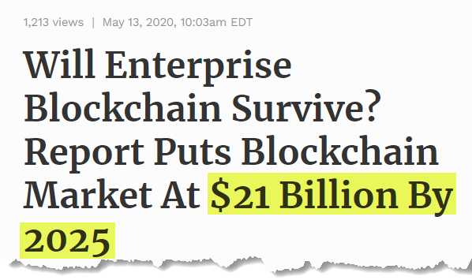
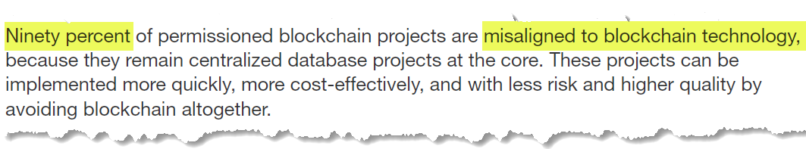
Blockchain market growth predictions are growing
https://www.forbes.com/sites/robertanzalone/2020/05/13/will-enterprise-blockchain-survive-a-new-report-says-that-the-blockchain-technology-market-will-reach-21-billion-by-2025/#7a5f793954b8

Slide 8

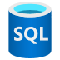
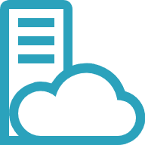


Blockchains are overkill for centralized scenarios
No data integrity off-chain
Decentralization requires all parties to host nodes on the network to participate in consensus
Governance rules must be established by the consortium and deployed/managed
Member 1
Latency associated with network consensus can impact transaction throughput (<1000 TPS for Ethereum)
Transaction Node(s)
Validator Node(s)
Off-chain storage patterns for querying data are a typical pattern, but data integrity is lost in the process
Member 2
Member 3
Bespoke development with immature tooling makes development and management challenging
Transaction Node(s)
Validator Node(s)
Transaction Node(s)
Validator Node(s)

Slide 9


Azure SQL Database Ledger
The power of blockchain with the simplicity of the SQL
Makes data in SQL tamper-evident through cryptography
Provides a historical record of all changes, verified through cryptographic proofs
The same SQL you already know across Azure and on-premises

Slide 10

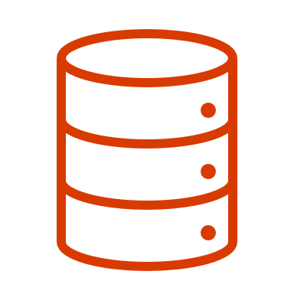
Ledger Tables – Updatable and Append-Only
Updatable Ledger Tables are standard SQL tables which allow updates and deletes
The history of rows that have been updated or deleted are preserved in the history table and easy-to-query Ledger View
Integrity of the updatable and history tables are maintained through cryptographic links from the Database Ledger
Ledger View
System periodically uploads digital receipts to a customer-configured trusted storage service
Updatable Ledger Table
History Table
Customer can use digital receipts to verify the integrity of the data
Append-Only Ledger Table
Append-Only Ledger Tables block UPDATE/DELETE at the API and remove the need for a history table
Block N
Block N-1
Block N-2
Trusted Storage
Database Ledger

Slide 11
Storage for database digests
Immutable Blob Storage
Azure Confidential Ledger (ACL)
Store data in a Write Once, Read Many state for perpetuity
Store data in a Write Once, Read Many state based on policies
Data blobs created can be set to read-only mode for a user-specified interval
Data blobs written to the ledger cannot be modified
Data is functionally locked or held based on policies
Runs on Confidential Enclaves which provides tamper-proof guarantees
Can provide audit logging support but must trust creator of the logs
Creates transaction receipts and serialized ledger files, which contain cryptographic constructs that can be verified by customers
Microsoft is in the trusted computing base
Microsoft is outside of TCB. Ledger source code is open source (CCF)

Slide 12


Demo

Slide 13
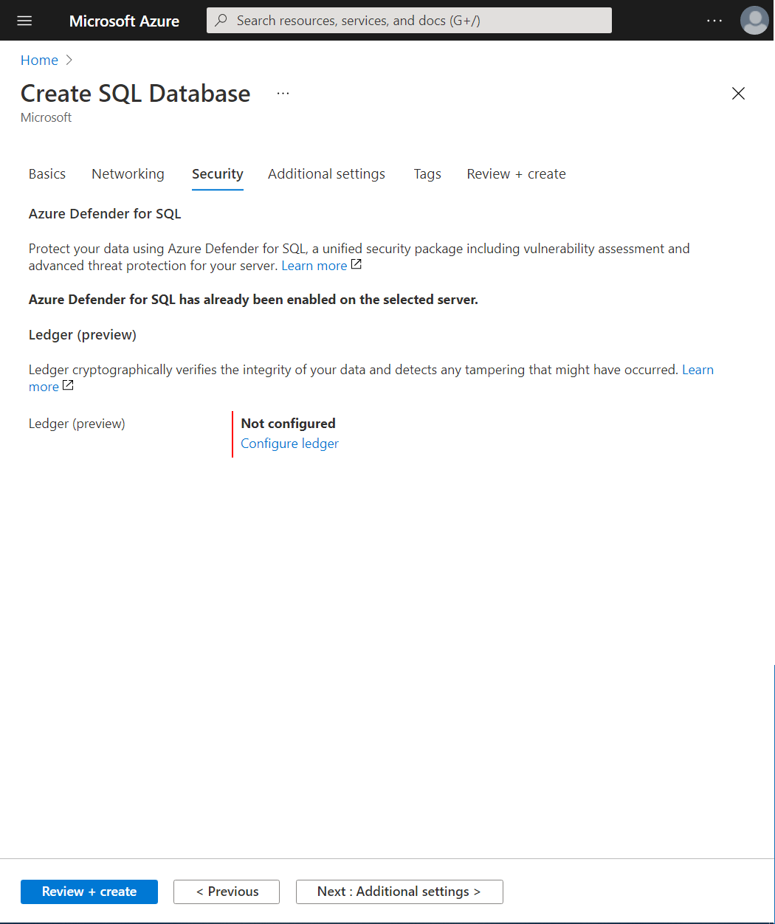
“Security” tab is new in the Create pane
Ledger configuration is not enabled by default

Slide 14
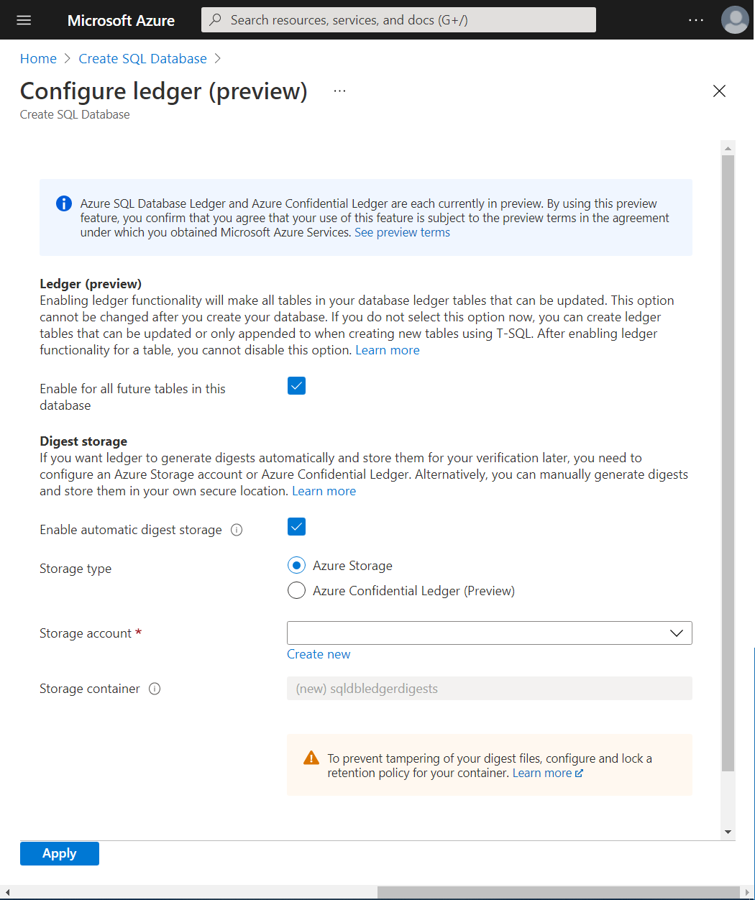
Enables “ledger database” ensuring all tables are updatable ledger tables
If not selected, users can still create ledger tables in T-SQL
Automatically generates digests and uploads to Azure Storage or ACL
If not selected, customers will have to manually generate and store their digests
Digests should be protected by an immutability policy

Slide 15
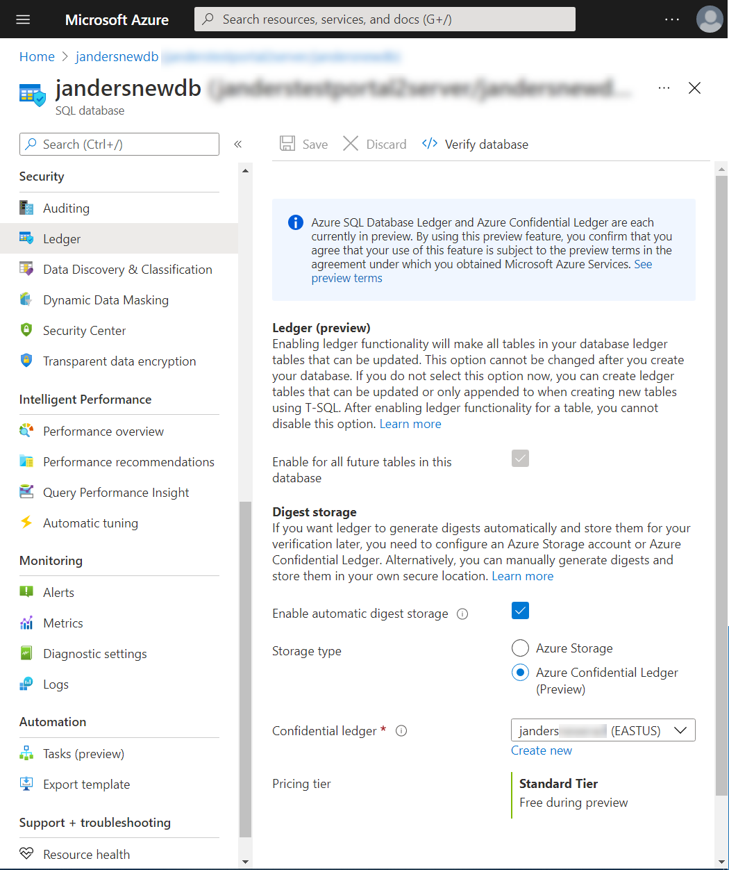
Ledger is in the Security section of the Manage experience
Ledger database cannot be disabled after Create
If not enabled during create, it cannot be enabled afterwards
Users can still create ledger tables using T-SQL
If ACL is chosen for digest storage, note that in Preview it is free, but will be charged at GA (Price TBD)

Slide 16
Verify database generates the T-SQL script to run database verification

Slide 17
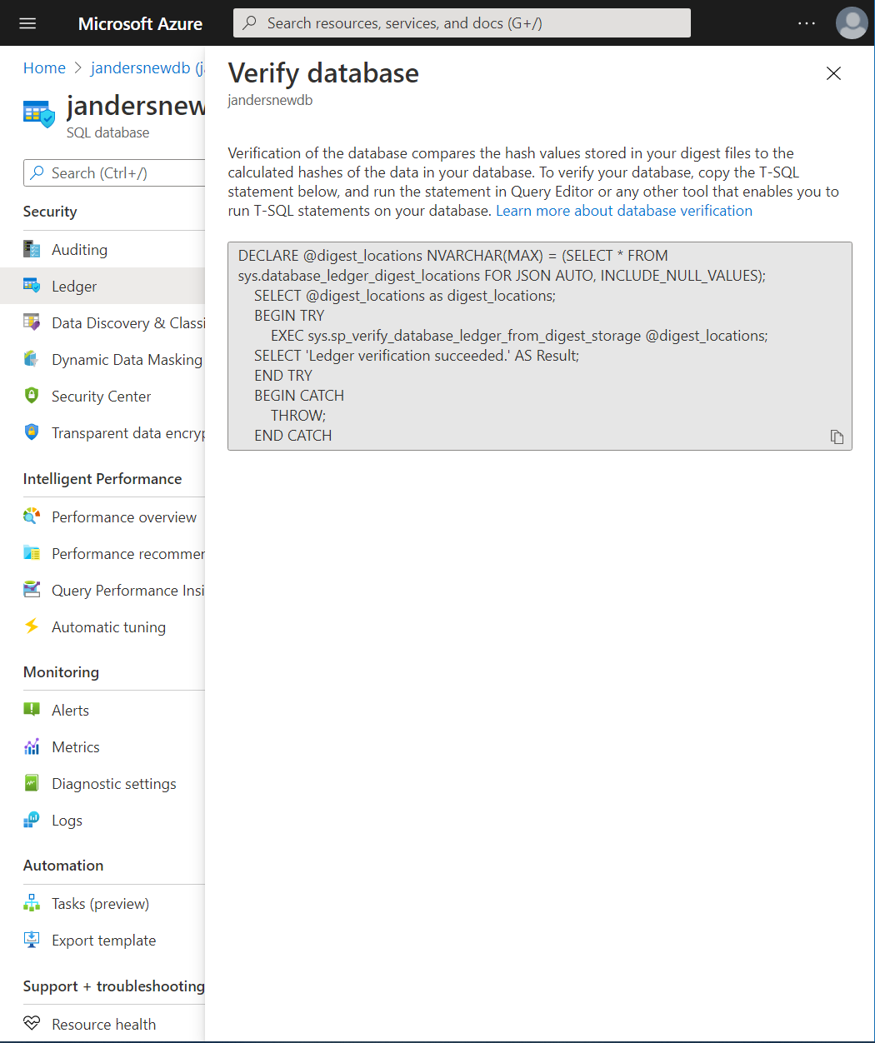
Copy the T-SQL for execution in Query Editor, Azure Data Studio or SQL Server Management Studio

Slide 18
Copy the T-SQL for execution in Query Editor, Azure Data Studio or SQL Server Management Studio

Slide 19
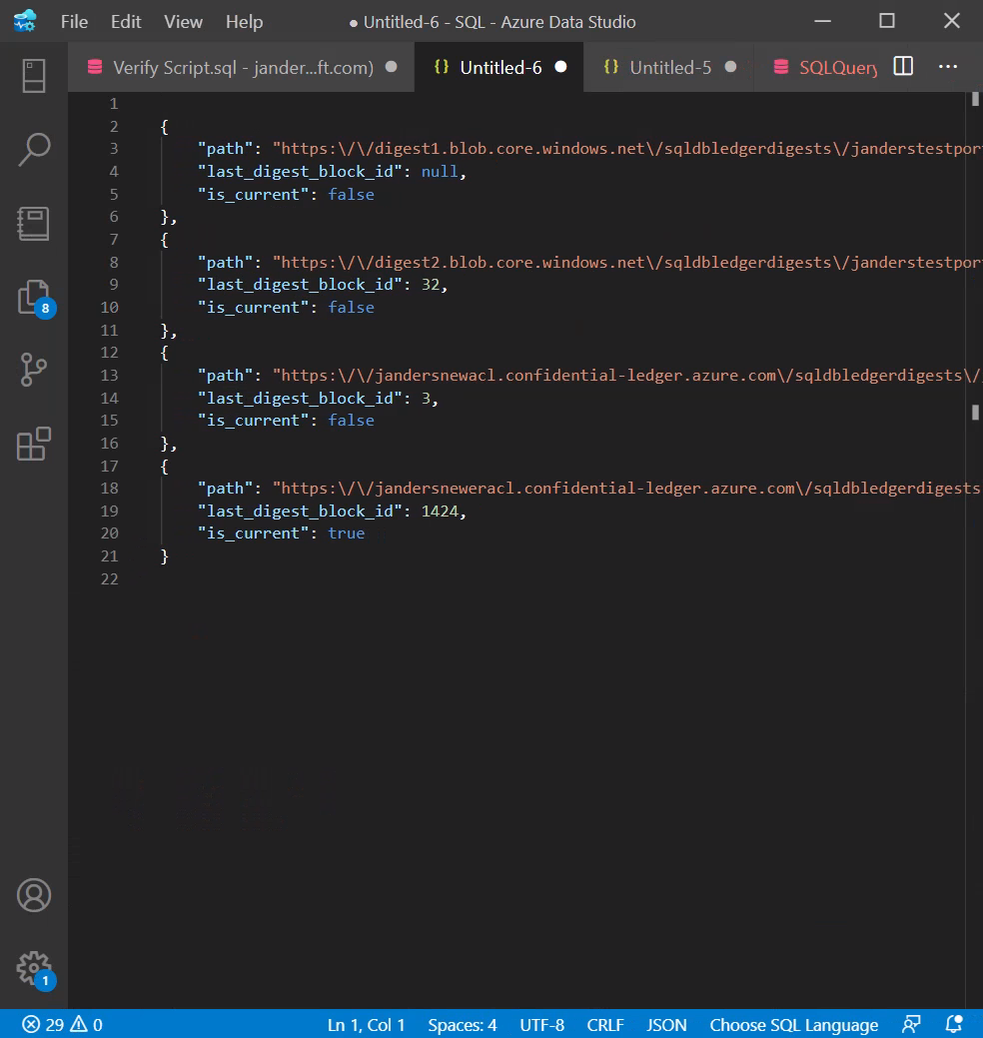
“false” indicates previous configuration of digest storage
“true” indicates the current configuration of digest storage

Slide 20
Scenarios
Streamlining the Audit Process
Cryptographically proving data has not been tampered to other parties whether internal or external ( auditors and regulators)
Multiparty Business Processes
Alternative to blockchain for systems that are centralised solutions at their core (trust, but verify)
Trusted off chain store for blockchain
Blockchain solutions typically replicates chain data “off-chain” to traditional databases. Ledger tables maintain integrity of the blockchain data

Slide 21




Ledger capability comparison
SQL ledger
AWS QLDB
Blockchain
Distributed architecture with decentralized consensus & business logic
Tokenization of assets
Centralized architecture providing tamper-evident proofs to users
Query ledger data in a performant manner without adding additional infra
Support for updates and deletes while maintaining forward integrity
Does not require new development, enable on existing systems
Support for on-prem, provisioned cloud and serverless
Ability to backup/restore ledger data while maintaining data integrity
Support for customer managed keys for encryption
Automated digest management

Slide 23

Are you a DevOps Engineer or Azure Admin?

Slide 24



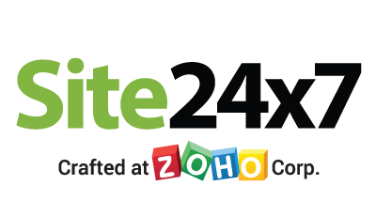
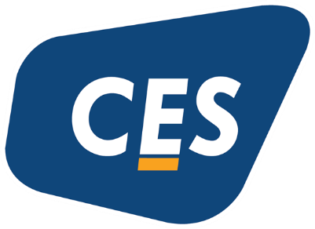

Platinum Partner
Gold Partner
Silver Partner

Slide 25

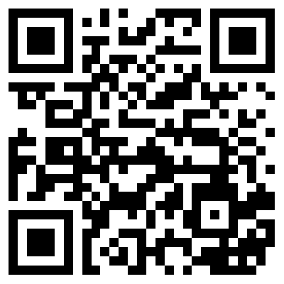
நன்றி
Securing your Data with the power of blockchain
Mohit Chhabra
Microsoft MVP Cloud Operations Manager/Architect
Presentation title
Linkedin.com/in/mohitchhabraazure

